Slide 1
Practical Project Management & Prof Development
A.V.A Chatbot
By:
Ayodamola Ajibola
Jia Ren Goh
Alex Moreton
Khawla Elmasalati

Slide 2
Presentation outlines
Brief Introduction
Project Aims and Objectives
Existing Alternatives
Development Approach
Results
Limitations and Future Work
Conclusion
Live Demo

Slide 3
Introduction

Slide 4
For my slides I will send alex on facebook a txt file for what to say in each one, and sure u can change if you want...
This what I have used
Font: titles 44 bold Calibri (Body),
Subtitles 28 bold Calibri (Body).
Content 28 Calibri (Body),
Figures 18 Calibri (Body),

Slide 5
Project’s Aims and objective
Way of presenting [just suggesting] so that we all have the same style and slides are consistent
Continues conversation.
Keyword detection.
Profile templates.
Storing user data to database.
Crossing platforms app.

Slide 6
Existing Alternatives
As mentioned by (AISB, 2017) organization Mitsuku chatbot is the winner of the Loebner Prize 2017.
A.V.A inspired by Mitsuku in the following advantages:
Learning from users.
Having :
1.Webpage.
2.Personality.
3.Avatar.

Slide 7
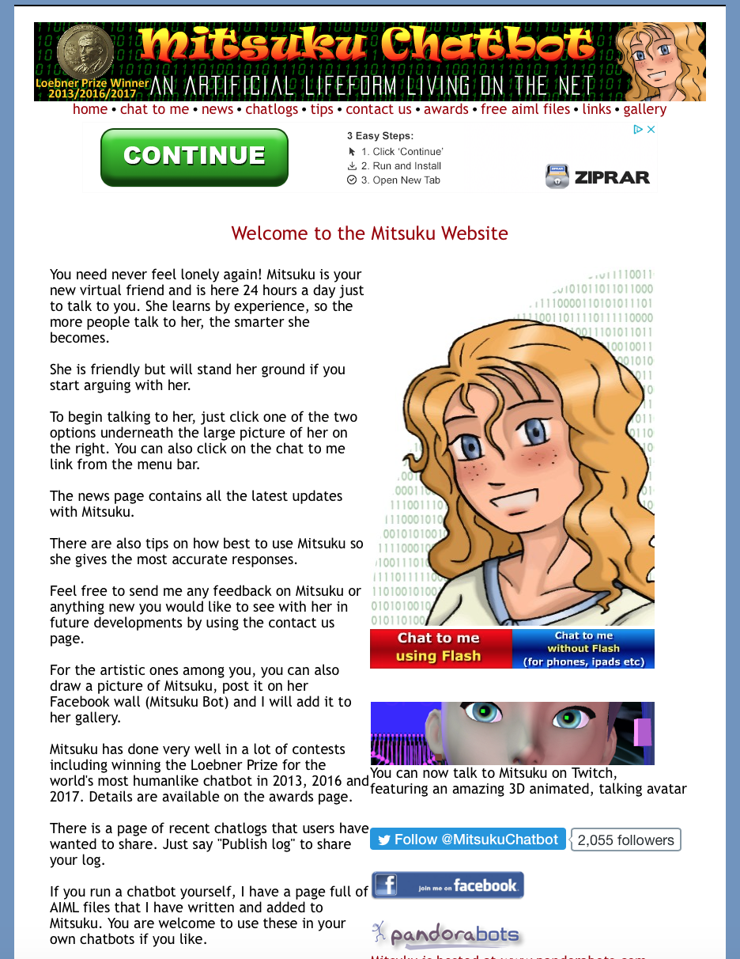
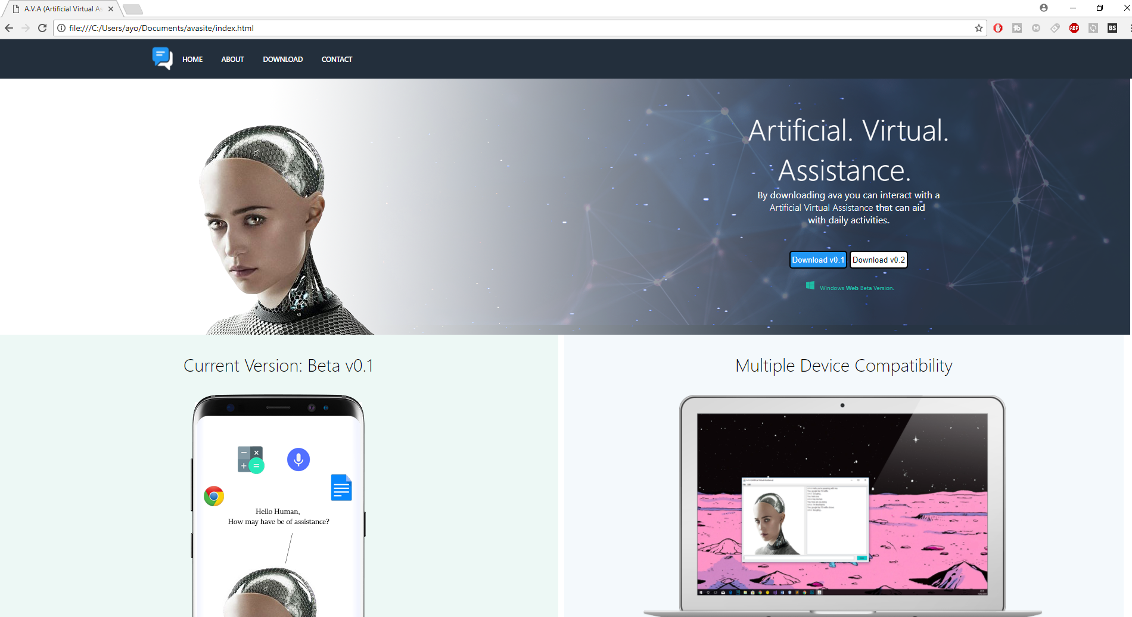
A.V.A improvements comparing to Mitsuku
Website design
Figure1: Mitsuku home webpage.
Figure 2: A.V.A home webpage.

Slide 8
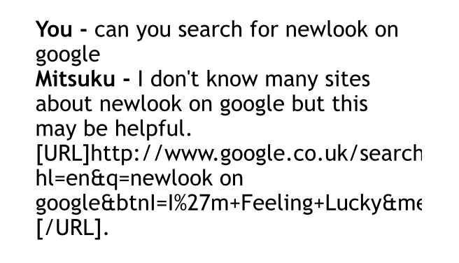
Cont’d
2. Google Searching feature
Img missing the zip file not opening
Figure 3: Mitsuku google search.
Figure 4: A.V.A google search.

Slide 9
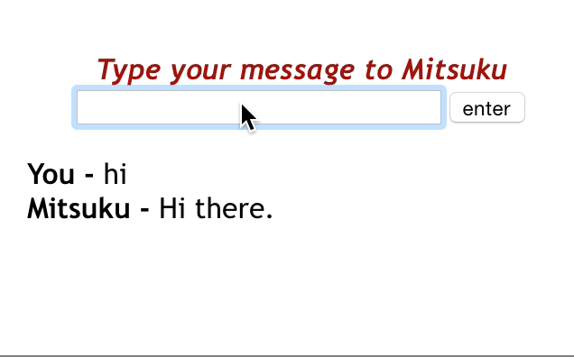
Cont’d
3. “Typing” feature
Video missing here same issue
Figure 5: Mitsuku typing.
Figure 6: A.V.A typing.

Slide 10
development approach

Slide 11
Results

Slide 12
limitations and ideas for future work as a minimum

Slide 13
Conclusion

Slide 14
References

Slide 15
Any Questions?

Slide 16
Live Demo

